Slide 1

The Organization’s Environments
External environment: everything outside an organization’s boundaries that might affect it. The uncontrollable environment.
Internal environment: the conditions and forces within an organization. The controllable environment.

Slide 2
The General Environment
Economic dimensions: the overall health and vitality of the economic system in which the organization operates.
Technical dimensions: the methods available for converting resources into products or services.
Socio-cultural dimensions: the customs, mores, values, and demographics of the society in which the organization functions.
Political-Legal dimension: the government regulation of business and the general relationship between business and government.
International dimension: the extent to which an organization is involved in or affected by business in other countries.

Slide 3
The Organizational Environment
Public
pressure
groups
Suppliers
Customers
The
Organization
Labor unions
Government
Competitors

Slide 4
The Task Environment
Competitors: an organization that competes with other organizations.
Customer: whoever pays money to acquire an organization’s products or services.
Supplier: an organization that provides resources for other organizations.
Regulator: a unit that has the potential to control, legislate, or influence an organization’s policies and practices.

Slide 5
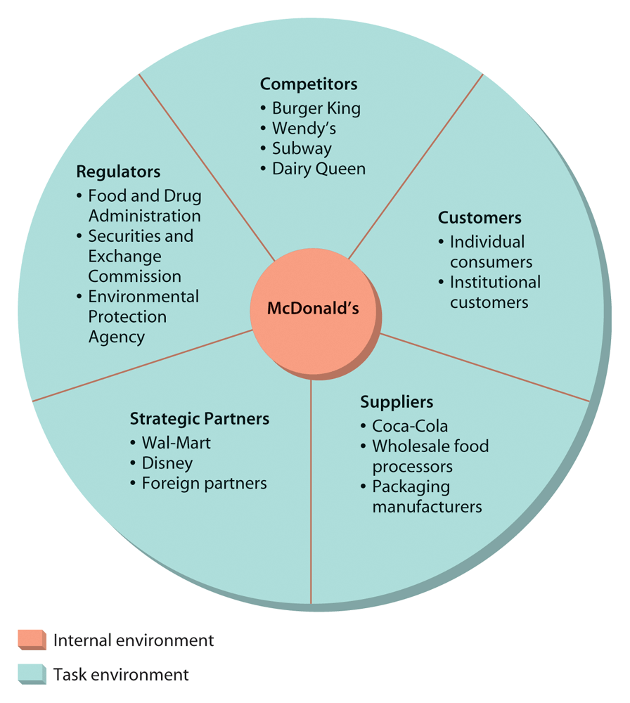

Slide 6
Task Environments Continued
Interest group: a group organized by its members to attempt to influence organizations.
Strategic partner: an organization working together with one or more organizations in a joint venture or other partnership.

Slide 7
The Internal Environment
Owner: someone who has legal property rights to a business.
Board of directors: governing body elected by a corporation’s stockholders and charged with overseeing the general management of the firm.
Employees: those employed by the organization.
Physical work environment: the firm’s facilities.

Slide 8
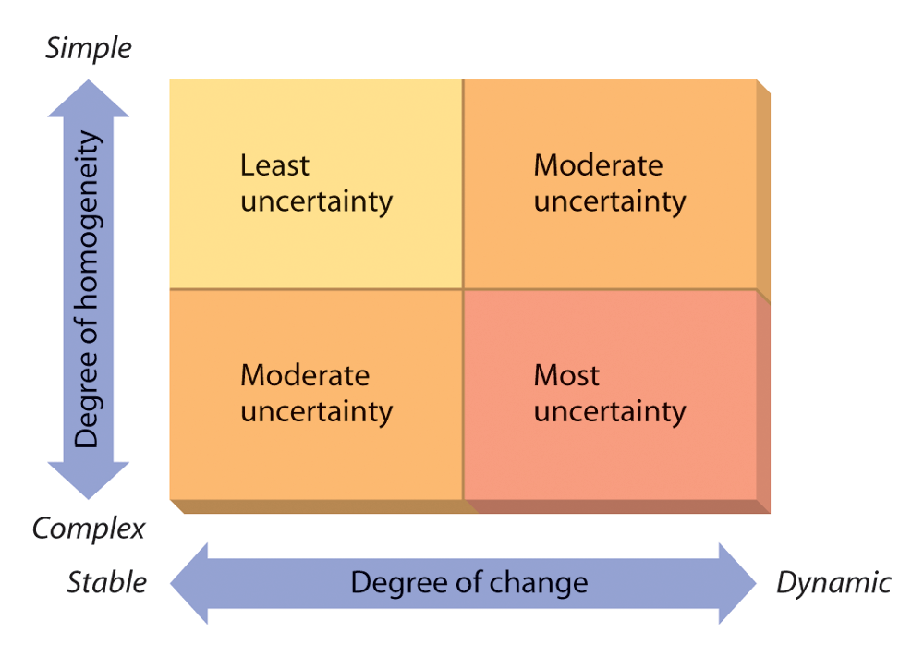
Figure 3.4: Environmental Change, Complexity, and Uncertainty

Slide 9
Organizational Culture
The set of values, beliefs, behaviors, customs, and attitudes that helps the members of the organization understand what it stands for, how it does things, and what it considers important.
Organizational culture is important for it determines the “feel” of the organization.
Its starting point is often the founder.

Slide 10
Managing Organizational Culture
The manager must understand the current culture and then decide if it should be maintained or changed.
Managers must walk a fine line between maintaining a culture that still works effectively versus changing a culture that has become dysfunctional.

Slide 11
Organizational Environment Relationships
Uncertainty: a driving force that influences many organizational decisions.
Competitive forces:
  Threat of new competitive entrants.
  Competitive rivalry.
  Threat of substitute products.
  The power of buyers.
  The power of suppliers.

Slide 12

Environmental Turbulence
Terrorist attacks.
Workplace violence.
Computer viruses.
Such crises affect organizations in different ways.

Slide 13
How Organizations Respond to Their Environments:
General environment
Task environment
Information
management
Mergers,
takeovers
acquisitions,
alliances
Social
responsibility
The
Organization
Strategic
responses
Direct
influence
Organization
design and
flexibility

Slide 14
How Organizations Adapt to Their Environments
Each organization must asses its own unique situation then adapt according to the wisdom of senior management, for example:
  Information systems.
  Strategic responses.
  Mergers, acquisitions, and alliances.
  Organizational design and flexibility.
  Direct influence of the environment.

Slide 15
The Environment and Organizational Effectiveness
How well the organization understands, reacts to, and influences its environment.
The systems resources approach: extent to which the organization can acquire needed resources.
The internal processes approach: internal mechanisms of the organization and forces on minimizing strain.
The goal approach: how well the firm obtains goals.
Strategic constituencies: groups who have a stake in the organization.

Slide 16
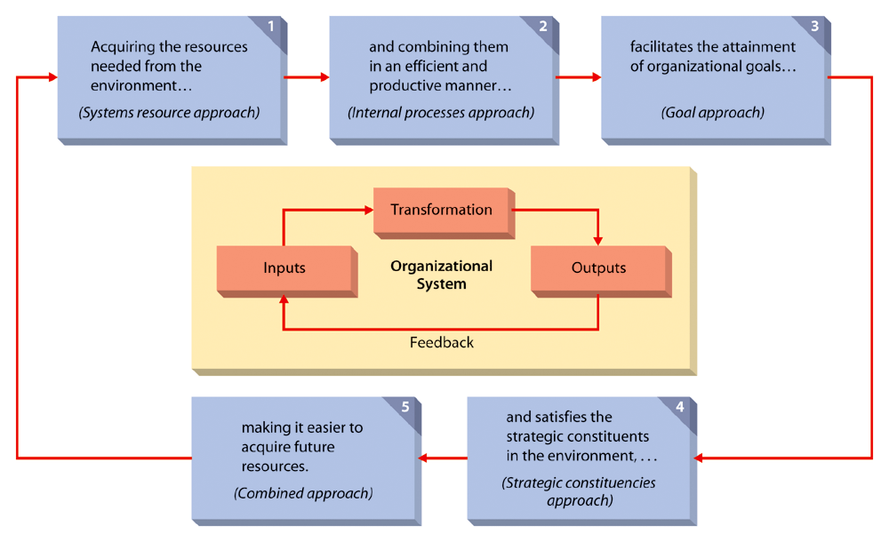
Figure 3.6: A Model of Organizational Effectiveness

Slide 17
